Slide 1
Calibrated Quantification
Christopher M. Shuford
Laboratory Corporation of America® Holdings

Slide 2
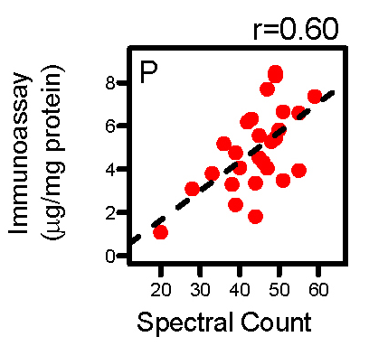
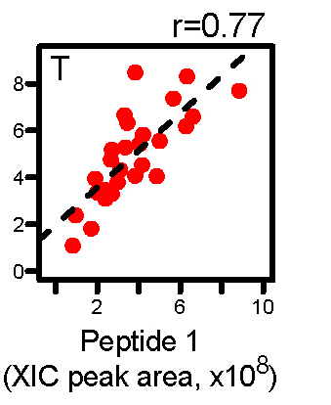
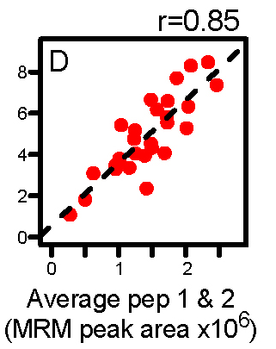
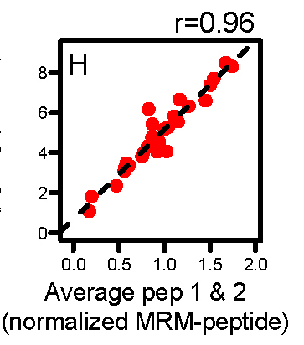
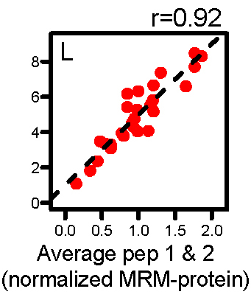
Why Calibrate?
reduce magnitude of analytical variance
(and increase accuracy of relative quantification)
Apolipoprotein E
Un-calibrated
“Calibrated” to Internal Standard
Courtesy of Andrew Hoofnagle, UW
A.N. Hoofnagle et al., Clin. Chem., 2012, 58(4), 777-781.

Slide 3
Internal Calibration
1 nmol
“known” amount of labeled signature peptide
sample
Proteolysis
(digestion)
Enrichment
LC-MS
Intensity
Elution time
unlabeled signature peptide (NAT) =
target protein
labeled internal calibrator peptide (SIL) =
incomplete proteolysis product =
contaminants
[NAT]
I_{NAT}
I_{NAT}
=
[NAT]
[SIL]
[SIL]
I_{SIL}
=
×
I_{SIL}

Slide 4
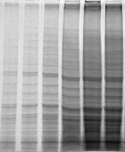
Internal Calibration Hierarchy
2
Concatamer
Protein
Protein-Level
Enrichment
Peptide-Level
Enrichment
LC-SRM Detection
1
Peptide
3
Digestion
NAT:SIL
(optional)
(optional)
time
[Protein] ≈ [Peptide_{NAT}] = [Peptide_{SIL}]
I_{NAT}
I_{SIL}
1
Full-length Protein: Desiderio, D. M. and co-workers, Biol. Mass Spectrom. 1991, 2(2), 149-156
Brun, V. and co-workers, Mol. Cell. Proteomics 2007, 6(12), 2139-2149
2
Peptide Concatemer: Beynon, R. J. and co-workers, Nat. Methods 2005, 2(8), 587-589
Beynon, R. J. and co-workers, Nat. Protocols 2006, 1(2), 1029-1043
3
(Partial) Peptide: Barr, J. R. and co-workers, Clin. Chem. 1996, 42(10), 1676-1682
Gygi, S. P. and co-workers, P. Natl. Acad. Sci. USA 2003, 100(12), 6940-6945.

Slide 5
Internal Calibration
2
Concatamer
Protein
Protein-Level
Enrichment
Peptide-Level
Enrichment
LC-SRM Detection
1
Peptide
3
Digestion
NAT:SIL
(optional)
(optional)
time
[Protein] ≈ [Peptide_{NAT}] = [Peptide_{SIL}]
I_{NAT}
I_{SIL}
Pitfalls:
Assume digestion is stoichiometrically complete (peptide and concatamers)
  Results vary by digestion/denaturation conditions
Reproducibility between digestions/days is critical
  Internal Calibrator must be stable
Response assumed to be linear

Slide 6
External Calibration: Multipoint
Qualified protein calibrator added to blank matrix
“known” amounts of Protein
1
5
10
50
External Calibration Samples
External Calibration Samples
constant amount of
internal standard
50
5
10
1
?
?
?
?
Unknown
Test Samples
Unknown
Samples
?
?
?
?
Without Internal Standard
With Internal Standard
100
40
8
20
NAT:SIL
Intensity Ratio
NAT Intensity
4
y=(m×x)+b
4
y=(m×x)+b
0.8
x=(y–b)/m
0.8
x=(y–b)/m
1
5
10
50
1
5
10
50
“known” Protein Amount
“known” Protein Amount

Slide 7
External Calibration: Multipoint
Qualified protein calibrator added to blank matrix
“known” amounts of Protein
1
5
10
50
External Calibration Samples
External Calibration Samples
constant amount of
internal standard
50
5
10
1
?
?
?
?
Unknown
Test Samples
Unknown
Samples
?
?
?
?
Pitfalls:
“Blank Matrix” must be essentially identical to sample matrix (requires verification)
Qualified protein should have same structure as endogenous protein (size, conformation, PTMs, etc)
External calibrators should be processed in parallel with unknown samples (added cost/time).
External calibrators must be stable

Slide 8
External Calibration: Single-point
Qualified protein calibrator added to blank matrix
“known” amount of Protein
5
5
5
5
External Calibration Samples
External Calibration Replicates
constant amount of
internal standard
5
5
5
5
?
?
?
?
Unknown
Test Samples
Unknown
Samples
?
?
?
?
Without Internal Standard
With Internal Standard
100
40
8
20
NAT:SIL
Intensity Ratio
NAT Intensity
4
y=(m×x)+0
4
y=(m×x)+0
0.8
x=y/m
0.8
x=y/m
1
5
10
50
1
5
10
50
“known” Protein Amount
“known” Protein Amount

Slide 9
External Calibration: Single-point
Qualified protein calibrator added to blank matrix
“known” amount of Protein
5
5
5
5
External Calibration Samples
External Calibration Replicates
constant amount of
internal standard
5
5
5
5
?
?
?
?
Unknown
Test Samples
Unknown
Samples
?
?
?
?
Pitfalls:
“Blank Matrix” must be essentially identical to sample matrix (requires verification)
Qualified protein should have same structure as endogenous protein (size, conformation, PTMs, etc)
External calibrators should be processed in parallel with unknown samples (added cost/time).
External calibrators must be stable
Response assumed to be linear

Slide 10
Additional Reading
Source of Analytical Variance in Proteomics
H.D. Cox et al., Clin. Chem. 2016, 60 (3), 541-548.
Peptide Degradation during Digestion
C.M. Shuford et al., Mol. Cel. Proteomics, 2012, 11 (9), 814-823.
More Peptides = More Confidence
Q. Fu et al., Clin. Chem. 2016, 62 (1), 198-207.
Single-point Calibration with Sample Pool
S.A. Agger et al., Clin. Chem. 2010, 56 (12), 1804-1813.
Analytical Verification in Translational Research
R.P. Grant and A.N. Hoofnagle, Clin. Chem. 2014, 60 (7), 941-944.

